Slide 1

Test Automation & Advanced Selenium
Introduction to Selenium
GIT
Lesson 02 - Introduction to GIT

Slide 2
Test Automation & Advanced Selenium
Introduction to Selenium
Lesson Objectives
To understand …
Git Basics
Getting a Git Repository
Recording Changes to the Repository
Viewing the Commit History
Undoing Things
Presentation Title | Author | Date
© 2017 Capgemini. All rights reserved.
2

Slide 3
Test Automation & Advanced Selenium
Introduction to Selenium
GIT Basics : What is GIT
Git is a distributed revision control and source code management (SCM) system with an emphasis on speed, data integrity and support for distributed, non-linear workflows.
As with most other distributed revision control systems, and unlike most client– server systems, every Git working directory is a full-fledged repository with complete
history and full version-tracking capabilities, independent of network access or a central server.
Like the Linux kernel, Git is free software distributed under the terms of the GNU General Public License version 2.
Presentation Title | Author | Date
© 2017 Capgemini. All rights reserved.
3

Slide 4
Test Automation & Advanced Selenium
Introduction to Selenium
GIT Basics : How does GIT handle data
Git deals with data like a series of snapshots of a miniature file system.
With Git, every time you commit, or save the state of your project, Git takes a picture of the files at that moment and stores a reference to that snapshot. T
To be efficient, if files have not changed, Git doesn’t store the file again, just a link to
the previous identical file it has already stored.
Git deals with data like a stream of snapshots.
Everything in Git is check-summed before it is stored and is then referred to by that checksum. So it’s impossible to change the contents of any file or directory without Git knowing about it, this functionality is built into Git at the lowest levels and you can’t lose information in transit or get file corruption without Git being able to detect it.
Presentation Title | Author | Date
© 2017 Capgemini. All rights reserved.
4

Slide 5
Test Automation & Advanced Selenium
Introduction to Selenium
GIT Basics : How does GIT handle data
Git uses SHA-1 hash mechanism for check-summ, it is a 40-character string composed of hexadecimal characters (0–9 and a–f) and calculated based on the contents of a file or directory structure in Git.
A SHA-1 hash looks something like this: 24b9da6552252987aa493b52f8696cd6d3b00373
Git stores everything in its database not by file name but by the hash value of its contents
All actions in Git, only add data to the Git database.
More in-depth look at how Git stores its data and how you can recover data that seems lost will b
Presentation Title | Author | Date
© 2017 Capgemini. All rights reserved.
5

Slide 6
Test Automation & Advanced Selenium
Introduction to Selenium
GIT Basics : GIT Operations
Most of the Git Operations are local in nature, since no information is needed from another computer on ther network.
The entire history of Git project is on local disk, so most local operations seem almost instantaneous.
The Git directory, the directory identified by you as a repository to store your data files, is where Git stores the metadata and object database for your project.
This is the most important part of Git, and it copied when you clone a repository from another computer to yours.
The working tree is a single checkout of one version of the project. These files are pulled out of the compressed database in the Git directory and placed on disk for you to use or modify.
Presentation Title | Author | Date
© 2017 Capgemini. All rights reserved.
6

Slide 7
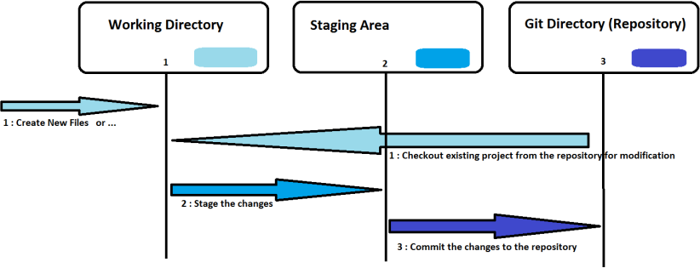
Test Automation & Advanced Selenium
Introduction to Selenium
GIT Basics : GIT Operations
The staging area is where cache where files to be committed, have their information stored about what will go into itsr next commit. Its technical name in Git parlance is the “index”, but the phrase “staging area” works just as well.
Presentation Title | Author | Date
© 2017 Capgemini. All rights reserved.
7

Slide 8
Test Automation & Advanced Selenium
Introduction to Selenium
GIT Basics : GIT Operations
In Git, any file can be in once to the three states : committed, modified, and staged.
Modified means that you have changed the file but have not committed it to your database yet. Or this can be new files created in the working tree/direcory.
Staged means that you have marked a modified file in its current version to go into your next commit snapshot.
Committed means that the data is safely stored in your local database
So, The basic Git workflow goes something like this:
You modify files in your working tree.
You selectively stage just those changes you want to be part of your next commit, which adds only those changes to the staging area.
You do a commit, which takes the files as they are in the staging area and stores that snapshot permanently to your Git directory.
Presentation Title | Author | Date
© 2017 Capgemini. All rights reserved.
8

Slide 9
Test Automation & Advanced Selenium
Introduction to Selenium
GIT Basics : GIT Operations
If a particular version of a file is in the Git directory, it’s considered committed.
If it has been modified and was added to the staging area, it is staged.
If it was changed since it was checked out but has not been staged, it is modified.
More in-depth look at these states and how you can either take advantage of them or skip the staged part entirely, is out of scope of this course, however the references are shared for further learning.
Presentation Title | Author | Date
© 2017 Capgemini. All rights reserved.
9

Slide 10
Test Automation & Advanced Selenium
Introduction to Selenium
Getting a GIT repository: Installing GIT
Install Git either as a package or via another installer, or download the source code and compile it yourself. Download and install as per your OS. Reference links are provided.
Git has a tool called git config that lets you get and set configuration variables that control all aspects of how Git looks and operates. These variables can be stored in three different places:
/etc/gitconfig file: Contains values applied to every user on the system and all their repositories. If you pass the option --system to git config, it reads and writes from this file specifically. (Because this is a system configuration file, you would need administrative or superuser privilege to make changes to it.)
~/.gitconfig or ~/.config/git/config file: Values specific personally to you, the user. You can make Git read and write to this file specifically by passing the --global option, and this affects all of the repositories you work with on your system.
config file in the Git directory (that is, .git/config) of whatever repository you’re currently using: Specific to that single repository. You can force Git to read from and write to this file with the --local option, but that is in fact the default. (Unsurprisingly, you need to be located somewhere in a Git repository for this option to work properly.)
Presentation Title | Author | Date
© 2017 Capgemini. All rights reserved.
10

Slide 11

Test Automation & Advanced Selenium
Introduction to Selenium
Getting a GIT repository: Installing & Configuring GIT
Each level overrides values in the previous level, so values in .git/config trump those in /etc/gitconfig.
On Windows systems, Git looks for the .gitconfig file in the $HOME directory (C:\Users\$USER for most people). It also still looks for /etc/gitconfig, it’s relative to the Sys root, that is wherever you decide to install Git on your Windows system when you run the installer.
After installing Git, set your user name and email address, since every Git commit uses this information. If you want to override this with a different name or email address for specific projects, you can run the command without the --global option when you’re in that project.
Presentation Title | Author | Date
© 2017 Capgemini. All rights reserved.
11

Slide 12
Test Automation & Advanced Selenium
Introduction to Selenium
Getting a GIT repository: Configuring GIT
To check configuration settings, use git config --list command to list all the settings Git can find at that point
Git reads the same key from different files (/etc/gitconfig and ~/.gitconfig, for example). and, Git uses the last value for each unique key it sees.
Check what Git uses as a specific key’s value is, by typing git config <key>
$ git config user.name
Query Git as to the origin for values it displays, and it will show configuration file had the final say in setting the values, use git config --show-origin rerere.autoUpdate command for this.
To get help while using Git, use git help <verb> for example : git help config
Presentation Title | Author | Date
© 2017 Capgemini. All rights reserved.
12

Slide 13
Test Automation & Advanced Selenium
Introduction to Selenium
Getting a GIT repository: Get a repository
Repository is a collection of refs together with an object database containing all objects which are reachable from the refs, possibly accompanied by meta data from one or more porcelains. A repository can share an object database with other repositories via alternates mechanism.
Get a Git repository in one of two ways, and end up with a Git repository on your local machine.
A local directory (either already existing or new to be crested) that is currently not under version control, is turned into a Git repository or
Clone an existing Git repository from elsewhere
Presentation Title | Author | Date
© 2017 Capgemini. All rights reserved.
13

Slide 14
Test Automation & Advanced Selenium
Introduction to Selenium
Getting a GIT repository: Get a repository
Local directory turned into a Git repository
at default location : git init
at particular location : git init /testGIT/gitrepo1
bare repository at default location : git init –bare
‒More on ‘bare repositories’ later …
Clone an existing Git repository from elsewhere
Following command That creates a directory named libgit2, initializes a .git directory inside it, pulls down all the data for that repository, and checks out a working copy of the latest version. : git clone https://github.com/libgit2/libgit2
Git has a number of different transfer protocols you can use apart
from https://protocol, like git:// or user@server:path/to/repo.git, which uses the SSH transfer protocol. More in-depth look at transfer protocols, is out of scope of this course,
however the references are shared for further learning.
Presentation Title | Author | Date
© 2017 Capgemini. All rights reserved.
14

Slide 15
Test Automation & Advanced Selenium
Introduction to Selenium
Recording changes to GIT repository
After setting up a Git repository typically, we start making changes and committing snapshots of those changes into the repository each time the project reaches a state we want to record.
Files in working directory can be in one of two states: tracked or untracked.
Tracked files are files that were in the last snapshot; they can be unmodified, modified, or staged. In short, tracked files are files that Git knows about i.e files in the staging area.
Untracked files are everything else — any files in working directory that are not in last snapshot and are not in your staging area.
When we first clone a repository, all of your files will be tracked and unmodified because Git just checked them out and haven’t been edited.
After editing the files, Git sees them as modified, because we’ve changed them since last commit. As we work, we selectively stage these modified files and then commit all those staged changes, and the cycle repeats.
Presentation Title | Author | Date
© 2017 Capgemini. All rights reserved.
15

Slide 16
Test Automation & Advanced Selenium
Introduction to Selenium
Recording changes to GIT repository
After setting up a Git repository typically, we start making changes and committing snapshots of those changes into the repository each time the project reaches a state we want to record.
Files in working directory can be in one of two states: tracked or untracked.
Tracked files are files that were in the last snapshot; they can be unmodified, modified, or staged. In short, tracked files are files that Git knows about i.e files in the staging area.
Untracked files are everything else — any files in working directory that are not in last snapshot and are not in your staging area.
When we first clone a repository, all of your files will be tracked and unmodified because Git just checked them out and haven’t been edited.
After editing the files, Git sees them as modified, because we’ve changed them since last commit. As we work, we selectively stage these modified files and then commit all those staged changes, and the cycle repeats.
Presentation Title | Author | Date
© 2017 Capgemini. All rights reserved.
16

Slide 17
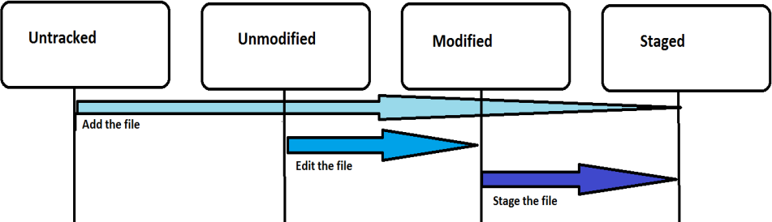

Test Automation & Advanced Selenium
Introduction to Selenium
Recording changes to GIT repository
Determine which files are in which state using the git status command.
Using the command git status -s or git status –short get simplified status of files
To ignore files that you don’t want Git to automatically like log files or system files create a file listing patterns to match them named .gitignore. Here is an example .gitignore file:
Presentation Title | Author | Date
© 2017 Capgemini. All rights reserved.
17

Slide 18
Test Automation & Advanced Selenium
Introduction to Selenium
Viewing commit history
Most basic and powerful tool to view commit history is the git log command.
git log -p -2
Using options is -p or --patch, which shows the difference (the patch output) introduced in each commit. You can also limit the number of log entries displayed, such as using -2 to show only the last two entries.
git log –stat
To see abbreviated stats for each commit, we can use the --stat option
git log --pretty=oneline
The option -–pretty changes the log output to formats other than the default.
The oneline option prints each commit on a single line. The short, full, and fulleroptions
show the output in roughly the same format but with less or more information, respectively
Presentation Title | Author | Date
© 2017 Capgemini. All rights reserved.
18

Slide 19
Test Automation & Advanced Selenium
Introduction to Selenium
Undoing Things
This is one of the few areas in Git where you may lose some work if you do it wrong.
One of the common undo takes place when commit is done too early and possibly we forget to add some files, or we mess up our commit message.
If you want to redo that commit, make the additional changes you forgot, stage them, and commit again using the --amend option: $ git commit –amend
The above command takes your staging area and uses it for the commit. If you’ve made no changes since the last commit, for instance, you run this command immediately after your previous commit, then your snapshot will look exactly the same, and all you’ll change is your commit message.
The same commit-message editor fires up, but it already contains the message of your previous commit. You can edit the message the same as always, but it overwrites your previous commit.
Presentation Title | Author | Date
© 2017 Capgemini. All rights reserved.
19

Slide 20
Test Automation & Advanced Selenium
Introduction to Selenium
Undoing Things
As an example, if you commit and then realize you forgot to stage the changes in a file you wanted to add to this commit, you can do something like this:
$ git commit -m 'initial commit'
$ git add forgotten_file
$ git commit --amend
Here you end up with a single commit, the second commit replaces the results of the first.
It’s important to understand that when you’re amending your last commit, you’re
not so much fixing it as replacing it entirely with a new, improved commit that pushes the old commit out of the way and puts the new commit in its place. Effectively, it’s as if the previous commit never happened, and it won’t show up in your repository history. The obvious value to amending commits is to make minor improvements to your last commit, without cluttering your repository history with commit messages of the form, “Oops, forgot to add a file” or “Darn, fixing a typo in last commit”.
Presentation Title | Author | Date
© 2017 Capgemini. All rights reserved.
20

Slide 21
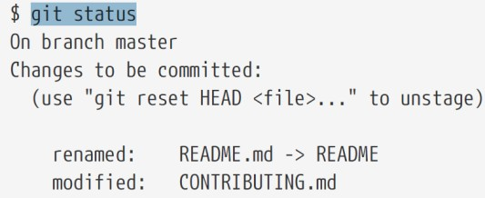
Test Automation & Advanced Selenium
Introduction to Selenium
Unstaging a Staged File
Here we determine the state of staging area and how to undo changes to staging area.
Assuming we want to commit two changed files as two separate changes, but we accidentally did it as git add * and staged the files. How can we unstage one of the two? The git status command reminds you of the status.
Presentation Title | Author | Date
© 2017 Capgemini. All rights reserved.
21

Slide 22
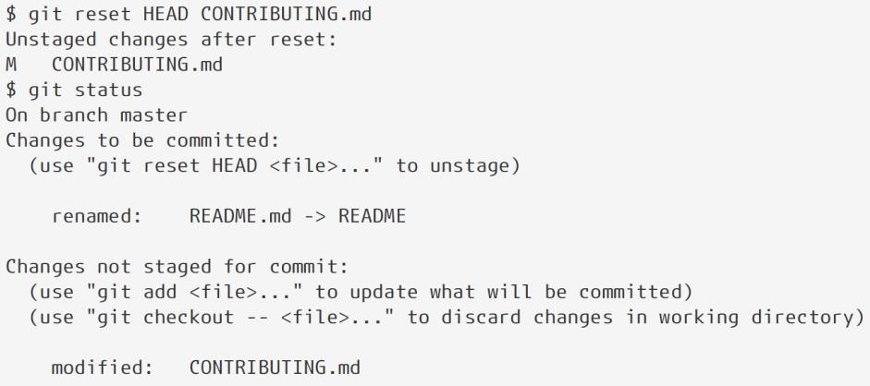
Test Automation & Advanced Selenium
Introduction to Selenium
Unstaging a Staged File
Now the CONTRIBUTING.md file is modified but once again unstaged. Use it with causion.
Presentation Title | Author | Date
© 2017 Capgemini. All rights reserved.
22

Slide 23
Test Automation & Advanced Selenium
Introduction to Selenium
Lesson1 demo1 : Working with GIT
# switch to home cd ~/ # create a directory and switch into it
mkdir ~/repo01
cd repo01 # create a new directory mkdir datafiles
# Initialize the Git repository# for the current directory
git init
# switch to your new repository
cd ~/repo01 # create another directory # and create a few files
mkdir datafiles
touch test01
touch test02
touch test03
touch datafiles/data.txt
# Put a little text into the first file
ls >test01
# add all files to the index of the # Git repository
git add .
Presentation Title | Author | Date
© 2017 Capgemini. All rights reserved.
23

Slide 24
Test Automation & Advanced Selenium
Introduction to Selenium
Lesson1 demo1 : Working with GIT continued
# switch to home cd ~/ # create a directory and switch into it
# commit your file to the local repository
git commit -m "Initial commit"
# show the Git log for the change
git log
# Create a file and commit it
touch nonsense2.txt git add . && git commit -m "more nonsense"
# remove the file via
Git git rm nonsense2.txt
# commit the removal
git commit -m "Removes nonsense2.txt file"
# Create a file and put it under version control
touch nonsense.txt git add . && git commit -m "a new file has been created"
# Remove the file
rm nonsense.txt
# Try standard way of committing -> will NOT work
git add . && git commit -m "a new file has been created"
Presentation Title | Author | Date
© 2017 Capgemini. All rights reserved.
24

Slide 25
Test Automation & Advanced Selenium
Introduction to Selenium
Lesson1 demo1 : Working with GIT continued
# switch to home cd ~/ # create a directory and switch into it
# commit the remove with the -a flag
git commit -a -m "File nonsense.txt is now removed"
# alternatively you could add deleted files to the staging index via
# git add -A .
# git commit -m "File nonsense.txt is now removed"
# create a file and add to index
touch unwantedstaged.txt
git add unwantedstaged.txt
# remove it from the index
git reset unwantedstaged.txt
# to cleanup, delete it
rm unwantedstaged.txt
# assume you have something to commit
git commit -m "message with a tpyo here"
git commit --amend -m "More changes - now correct"
Presentation Title | Author | Date
© 2017 Capgemini. All rights reserved.
25

Slide 26

Test Automation & Advanced Selenium
Introduction to Selenium
Summary
In this lesson, you have learnt
Git Basics
Getting a Git Repository
Recording Changes to the Repository
Viewing the Commit History
Undoing Things
Add the notes here.

